Slide 1
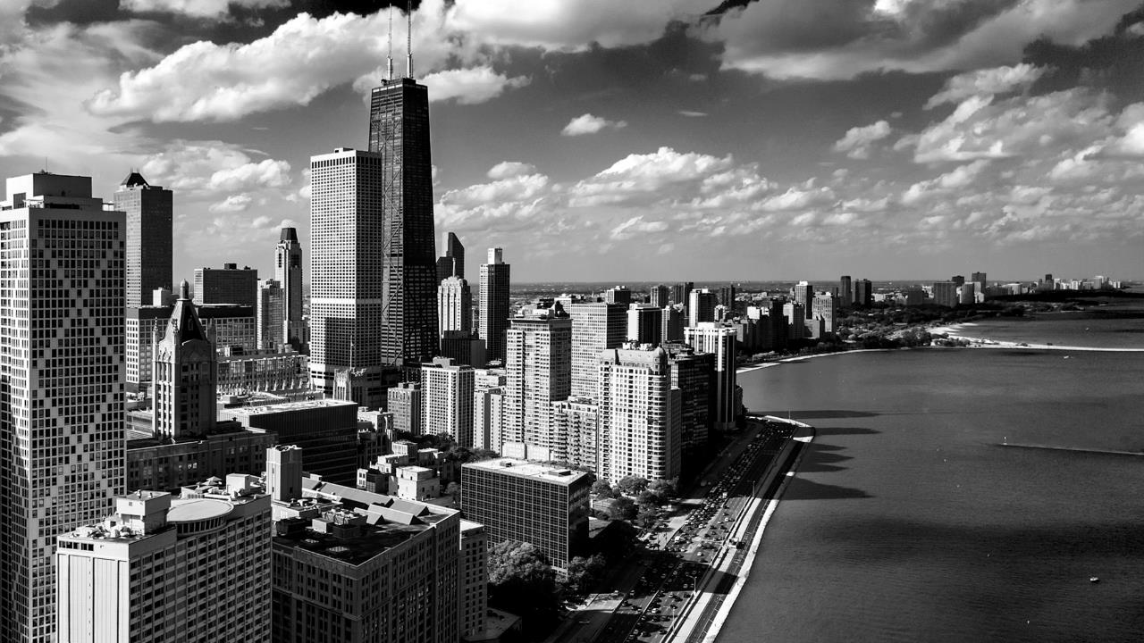
Navigating
Microsoft Graph API
with PowerShell
Notes:
Some really good links we think simplifies a lot Graph:
https://www.one-tab.com/page/WQtmEp4rTCyg4gT_UluG0Q
http://bit.ly/2H2YHx9

Slide 2



TODAY’S
Speakers
Bradley Wyatt, MCP
Senior Consultant, Technical Specialist at Porcaro Stolarek Mete Partners, LLC
Author at LazyAdministrator.com
github.com/bwya77
Jocel Sabellano
Senior IT Consultant at Porcaro Stolarek Mete Partners, LLC
I write automations
github.com/theitrx
2

Slide 3
TODAY’S
Agenda
What is Microsoft Graph API
Overview of Microsoft Graph API
Benefits of knowing Graph
What applications or automations can you make with Graph
Graph vs PSSession
Connection difference
Output object and format
Authentication
Authenticate to Graph API
Grant Types
Requesting a token
Needed request Body
Manipulating Graph Data
Using query parameters
Converting to other output formats
Pagination
Reporting Using Graph API
Creating reports using ReportHTML
Creating alerts from reports
Other Use Cases
Send message to teams
Uploading to OneDrive
Creating a Sharepoint List
3

Slide 4
OVERVIEW OF MICROSOFT GRAPH API
WHAT IS AN API
Wikipedia
“An Application Programming Interface (API) is a set of functions, procedures, methods or classes used by computer programs to request services from the operating system, software libraries or any other service providers running on the computer. A computer programmer uses the API to make application programs.”
– Wikipedia.com
Techtarget
“An application program interface (API) is code that allows two software programs to communicate with each other.”
– Techtarget.com
ELI5
“It's a way for 2 different computer programs to speak to each other. The API is the list of commands that the program understands.”
- r/brainflakes
4

Slide 5
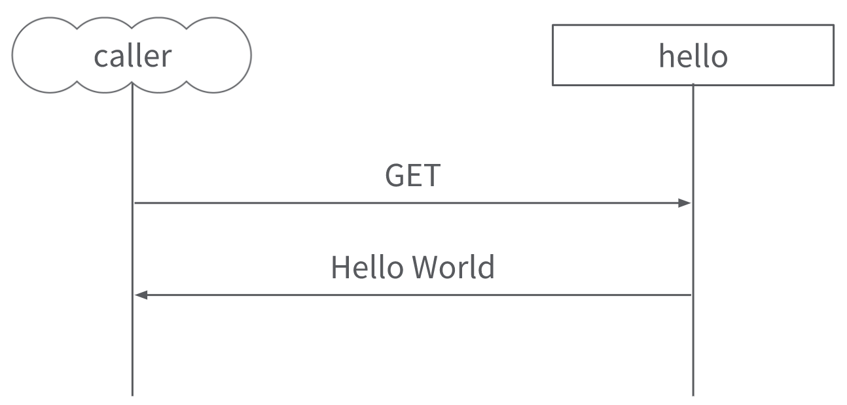
OVERVIEW OF MICROSOFT GRAPH API
WHAT IS REST API
REpresentational State Transfer API
Uses HTTP Methodologies
GET – Retrieve a resource
PUT – Replace a resource with a new one
POST – Create a resource
DELETE – Delete or remove a resource
PATCH – Update a resource
Client – Server Model
Client – Application initiating the request
Server – Serving the request
Output Formats
XML
CSV
JSON
5
Notes:
http://bit.ly/2RGm7Mw

Slide 6
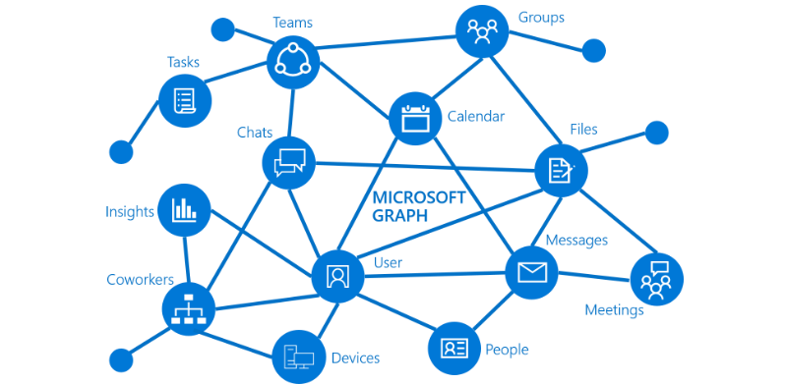
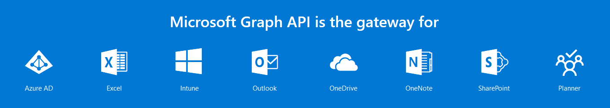
OVERVIEW OF MICROSOFT GRAPH API
WHAT IS MICROSOFT GRAPH
Is a REST API, a unified endpoint
That gives you access to
Azure AD
Excel
Intune
Outlook
Onedrive
Sharepoint
Planner
..and More!
And you can
Generate reports and audit data
Perform hundreds of tasks programmatically
Build automations or apps
..and more!
6
Notes:
Benefits:
. You are flexible with almost a lot of management tasks. There are a lot of things you can’t do in the portal that you can do with Graph
. You can process batches or numerous tasks in a short amount of time
. You can be more innovative to whatever you can come up with
. You’re awesome.
Sample applications:
. Automated onboarding of users
. Custom reporting
. Custom auditing
. Custom dashboard

Slide 7
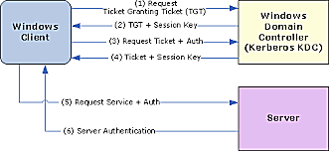
GRAPH VS PSSESSION
AUTHENTICATION
PSSESSION
Uses Active Directory or Local Account Creds
Username
Password
Types
CredSSP
Kerberos
Digest
PSCredential Object
7
Notes:
http://bit.ly/2RwJVlG
Kerberos is the default method of authentication when the client is in a domain and the remote destination string is not one of the following: localhost, 127.0.0.1, or [::1].
Negotiate is the default method when the client is not in a domain, but the remote destination string is one of the following: localhost, 127.0.0.1, or [::1].

Slide 8
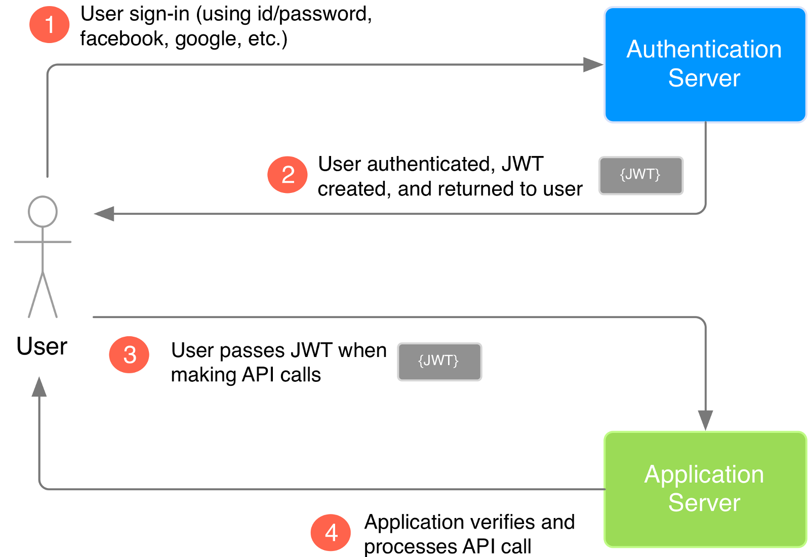
GRAPH VS PSSESSION
AUTHENTICATION
GRAPH API
HTTP
Azure AD Application
Application ID
Application Secret
Microsoft / Azure AD Account
Username
Password
JSON Web Token
Authentication code
Device code
8
Notes:
In general:
You authenticate and you get a token.
You get a token then you attach it as a body of your API request.
With right permission, grants, username/password, etc. You should be able to talk to Graph API endpoint.

Slide 9
GRAPH VS PSSESSION
COMMAND AND OUTPUT TYPES
GRAPH API
Port Requirements: TCP:443(HTTPS)
Commands
Invoke-RestMethod
PSCustomObject
JSON
CSV
Invoke-WebRequest
JSON
CSV
PSSESSION
Port Requirement: TCP: 5985(HTTP) or 5986 (HTTPS)
WINRM
Commands
Invoke-Command
Deserialized Object
Enter-PSSession
Object is intact
9
Notes:
http://bit.ly/2K1kubl – information about deserialization
Rest-Method auto converts JSON to PSCustomObject. You can convert it to RAW json by convertTo-JSON

Slide 10
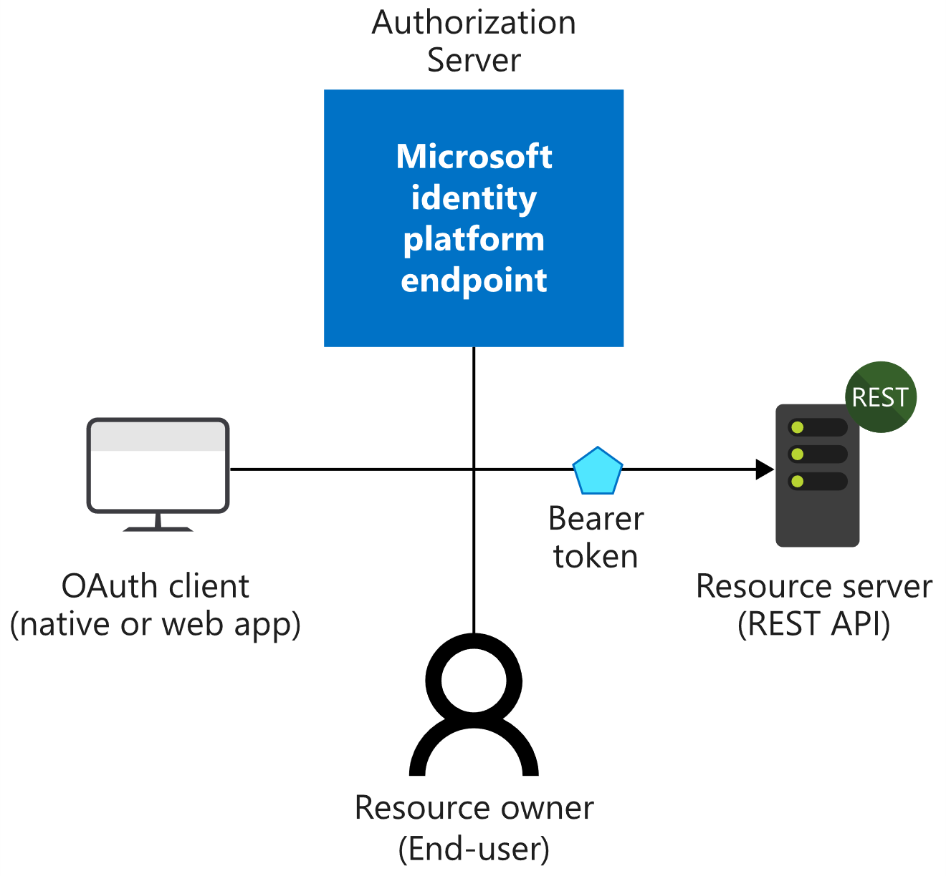
AUTHENTICATE TO GRAPH API
OBJECTS YOU NEED
Azure AD Application
Needed to Acquire an Access Token
Application (client) ID
Application (client) Secret
Directory (tenant) ID
Permissions
User or Admin Consent
AAD User Account Credentials (Some Endpoints)
Access Token
Needed to Access Graph API
JSON Web Token (JWT)
Graph API Endpoint
Where you will send your request
https://graph.microsoft.com/v1.0/
https://graph.microsoft.com/beta/
Format
https://graph.Microsoft.com
/{version}
/{resource}
/{id}
/{property}
/{query-parameters}
10
Notes:
AAD app is the logical object of your app/automation. This works the same way as if you have a Facebook app. Permissions are assigned to your AAD App. It’s sort of the identity for your application within azure AD.
AAD App is the prerequisite to get access token. Access token is the prerequisite to talk to Graph API

Slide 11
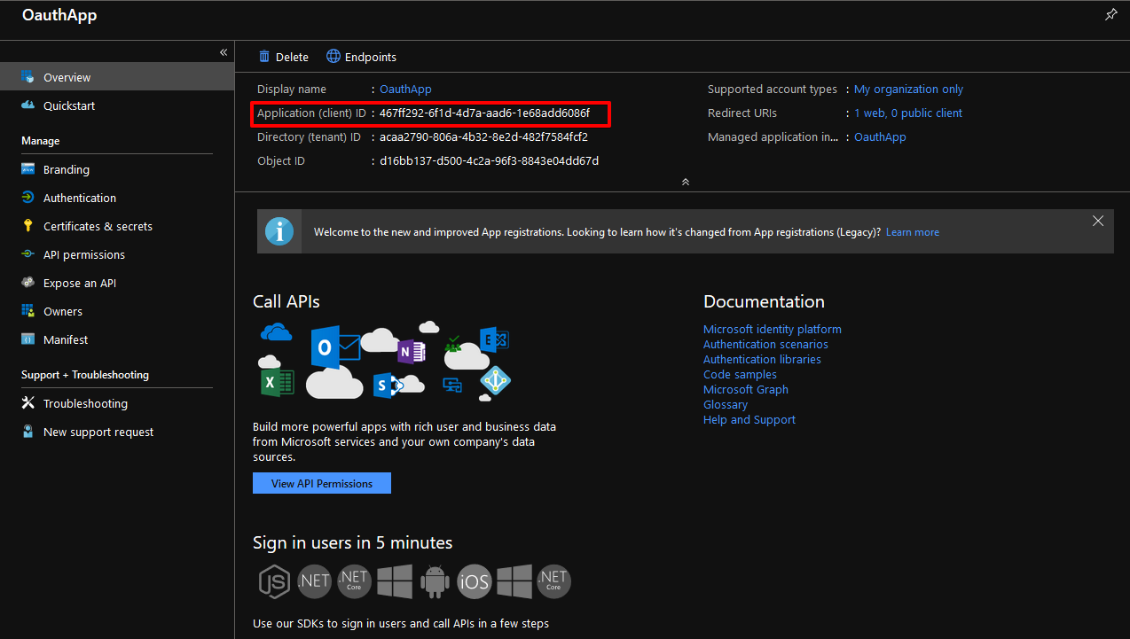
AUTHENTICATE TO GRAPH API
Azure AD Application
Azure AD Application
Application (client) ID
Application (client) Secret
Directory (tenant) ID
Permissions
User or Admin Consent
Azure AD User Account Credentials
11

Slide 12
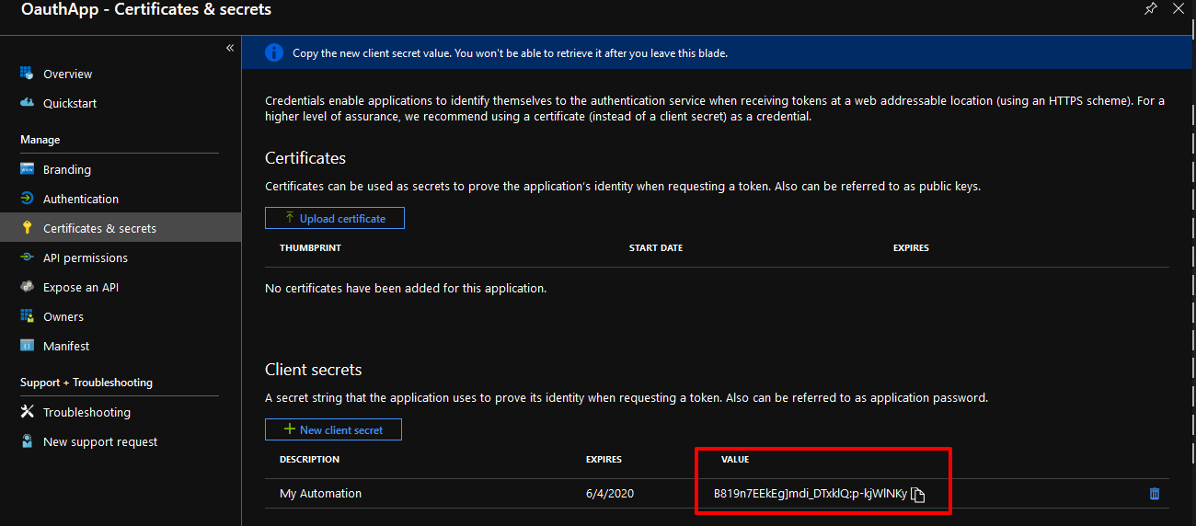
AUTHENTICATE TO GRAPH API
Azure AD Application
Azure AD Application
Application (client) ID
Application (client) Secret
Directory (tenant) ID
Permissions
User or Admin Consent
AAD User Account Credentials
12

Slide 13

AUTHENTICATE TO GRAPH API
Azure AD Application
Azure AD Application
Application (client) ID
Application (client) Secret
Directory (tenant) ID
Permissions
User or Admin Consent
Azure AD User Account Credentials
13

Slide 14
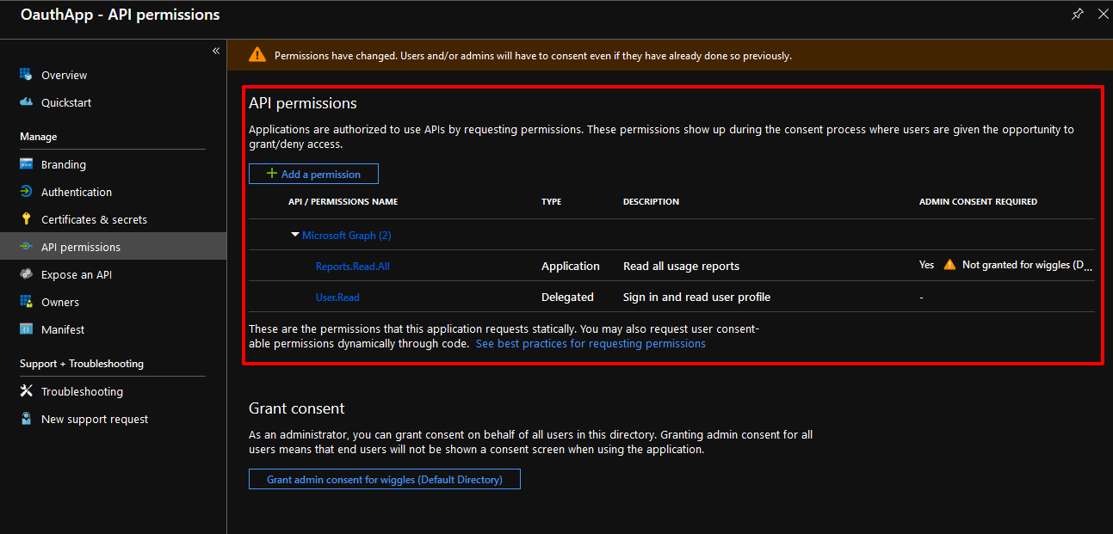
AUTHENTICATE TO GRAPH API
Azure AD Application
Azure AD Application
Application (client) ID
Application (client) Secret
Directory (tenant) ID
Permissions
User or Admin Consent
Azure AD User Account Credentials
14

Slide 15
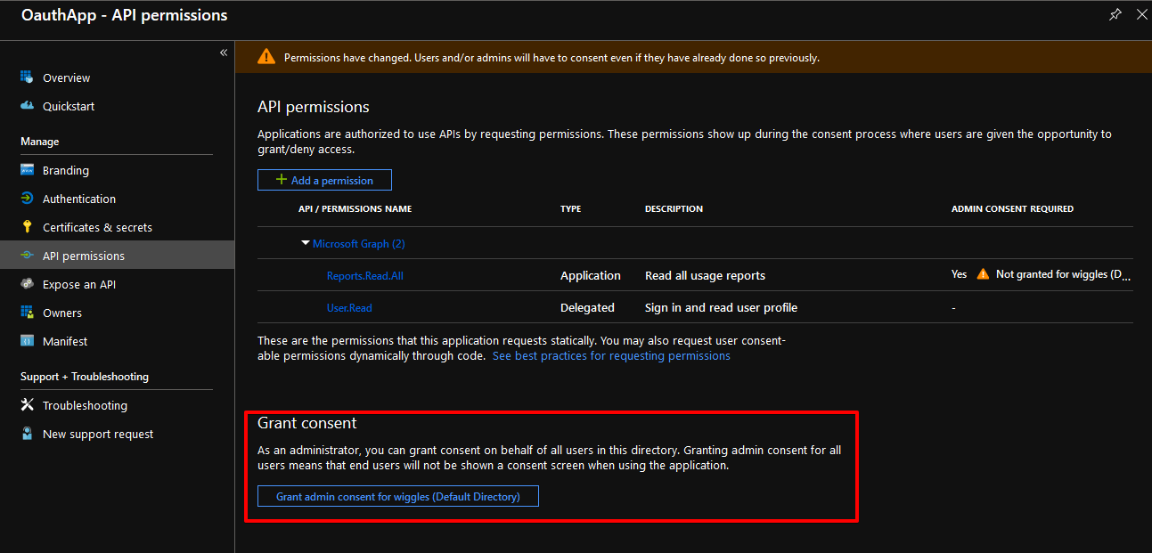
AUTHENTICATE TO GRAPH API
Azure AD Application
Azure AD Application
Application (client) ID
Application (client) Secret
Directory (tenant) ID
Permissions
User or Admin Consent
Azure AD User Account Credentials
15

Slide 16
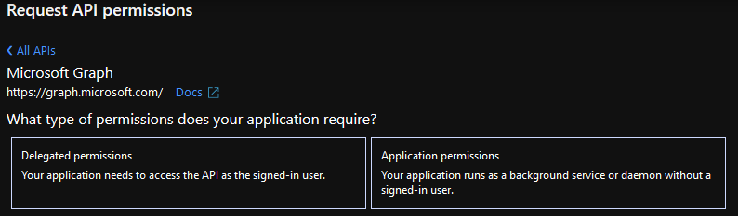
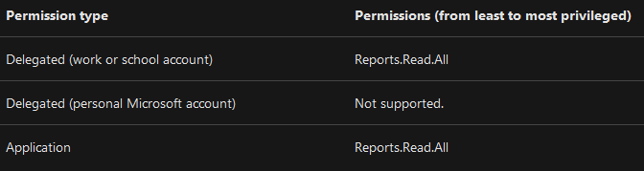
AUTHENTICATE TO GRAPH API
APP PERMISSIONS
Delegated
Resources that need user context
E.g. Sending email or message to teams
Needs user or admin consent
Application
App-only – without a user
Best for daemon apps
Only admin can consent
16
Notes:
Delegated permissions - Are used by apps that have a signed-in user present. For these apps, either the user or an administrator consents to the permissions that the app requests and the app is delegated permission to act as the signed-in user when making calls to an API. Depending on the API, the user may not be able to consent to the API directly and would instead require an administrator to provide "admin consent".
Application permissions - Are used by apps that run without a signed-in user present; for example, apps that run as background services or daemons. Application permissions can only be consented by an administrator because they are typically powerful and allow access to data across user-boundaries, or data that would otherwise be restricted to administrators.
http://bit.ly/2RAGv1e

Slide 17
AUTHENTICATE TO GRAPH API
USER AUTH | ADMIN CONSENT
USER
https://login.microsoftonline.com
/{tenant}
/oauth2
/v2.0
/authorize
?client_id={client ID}
&response_type=code
&redirect_uri={Redirect URL in the Azure app}
&scope=https://graph.Microsoft.com
/.{permission.code} offline_access
ADMIN
https://login.microsoftonline.com
/{tenant}
/adminconsent
?client_id={client ID}
&redirect_uri={Redirect URL in the Azure app}
17
Notes:
. Permissions won’t work without user or admin consent.
. User authorization is used for delegated permissions. Some endpoints need admin consent to work.
. Admin consent is needed on some app permissions.
http://bit.ly/2RAGiv7

Slide 18
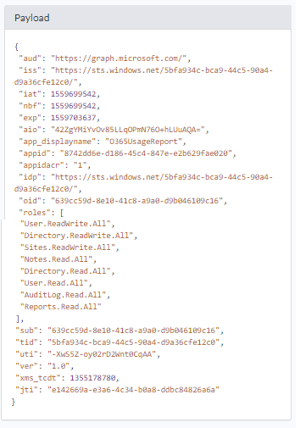
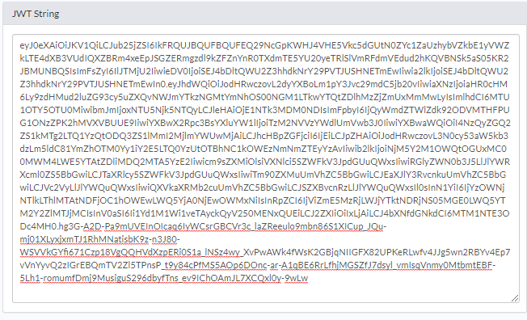
AUTHENTICATE TO GRAPH API
Access Token
Access Token
Needed to Access Graph API
JSON Web Token (JWT)
https://login.microsoftonline.com
/{Tenant ID | “common”}
/oauth2
/v2.0
/token
$ReqHeader = @{
Authorization = "Bearer $Token"
}
18
Notes:
JWT encoded. A signed base 64 string.
http://bit.ly/2RElFyb

Slide 19
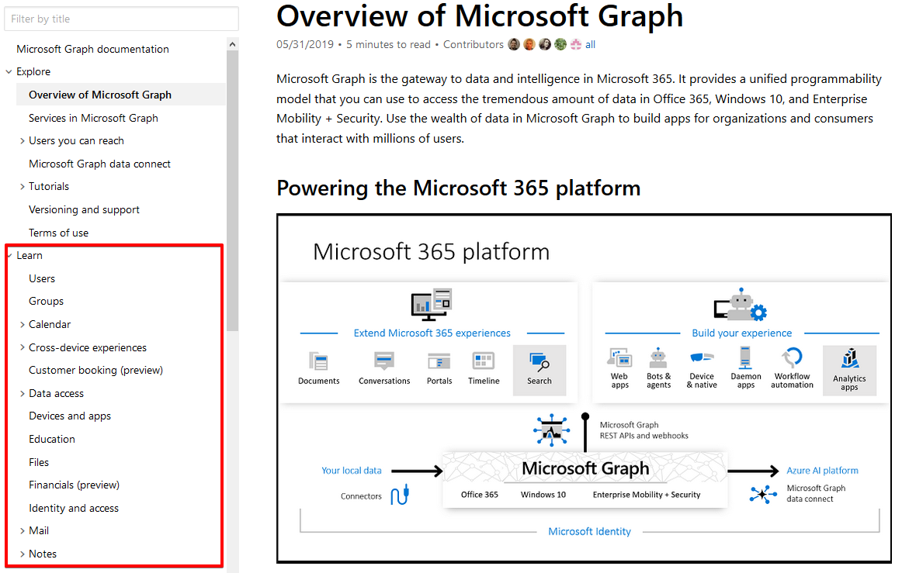
AUTHENTICATE TO GRAPH API
API Endpoint
How to Know the Endpoint?
https://docs.microsoft.com
/graph
/overview
Examples:
https://graph.microsoft.com/v1.0
Reports - /reports/
Audit Logs - /auditLogs/
Onedrive - /me/drive/
Mail Drafts - /me/mailfolders(‘Drafts’)/
Sharepoint - /sites/
19

Slide 20
AUTHENTICATE TO GRAPH API
GRANT TYPES
Client_Credentials
Best used for daemon apps
Uses Azure AD App only for authentication
Application permissions are used
No user context
Needs admin consent for permissions
Password
Contains user context
Needs AAD user creds
Creates a refresh token (Scope: Offline_Access)
Does not support web based authentication
Authorization_Code
Best used for web or mobile applications
Contains user context
Supports modern authentication methods
Device_Code
Best used when no HTML based authentication is available locally
Supports modern authentication methods
Refresh_Token
Needs the refresh token to generate a new token.
Refresh token is can be reused for 90 days
20
Notes:
Grant types are chosen based off the way how you authenticate or acquire your access token.
All the Grant types and documentation:
http://bit.ly/2REuoAC

Slide 21
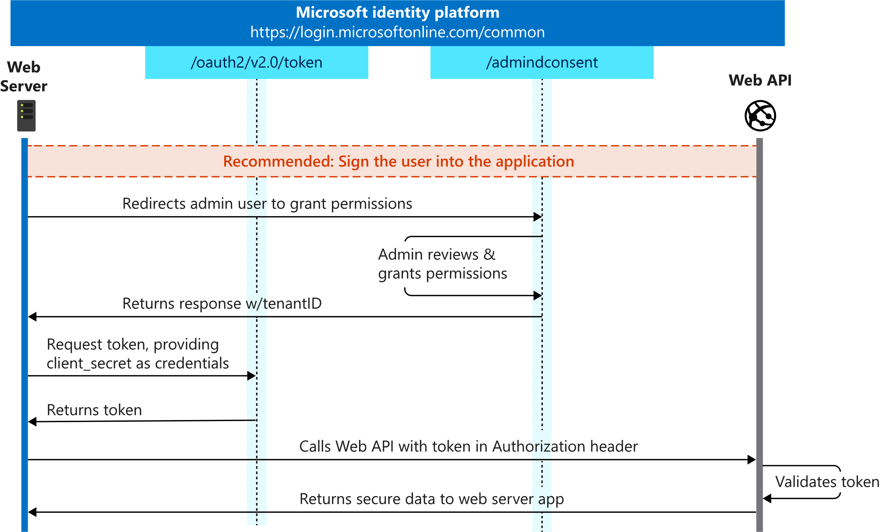
AUTHENTICATE TO GRAPH API
GRANT TYPES
\
Client_Credentials
Required POST Body:
Grant_Type = Client_Credentials
Client_ID = “{Azure App Client ID}”
Client_Secret = “{Azure App Client Secret}”
Scope = https://graph.microsoft.com/.default
21

Slide 22
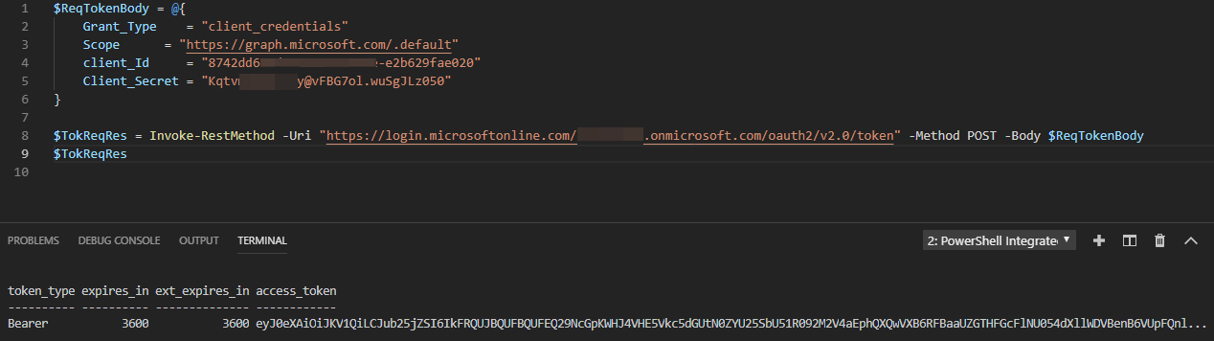
CLIENT CREDENTIAL - STITCHING THE COMPONENTS
REQUESTING TOKEN
22

Slide 23
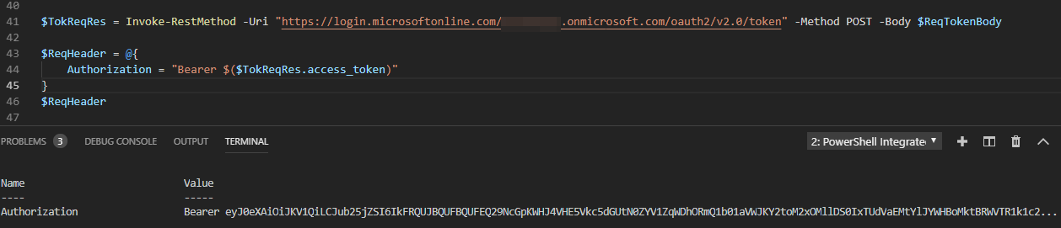
CLIENT CREDENTIAL - STITCHING THE COMPONENTS
TOKEN RESULT
23

Slide 24
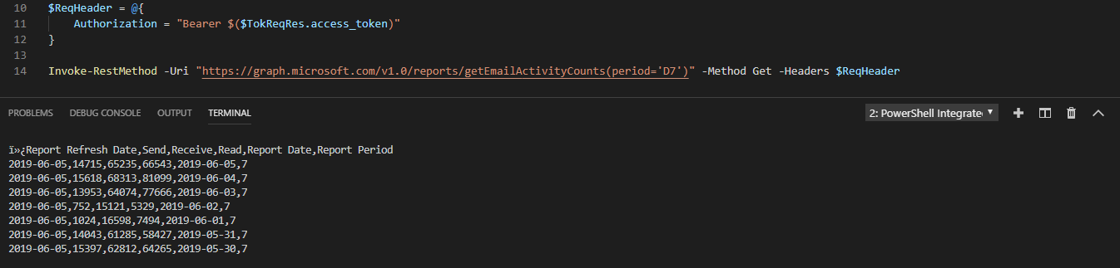
CLIENT CREDENTIAL - STITCHING THE COMPONENTS
SENDING TO GRAPH
24

Slide 25
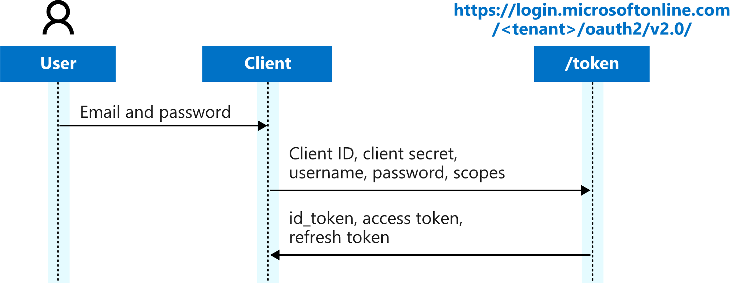
AUTHENTICATE TO GRAPH API
GRANT TYPES
Password
Required POST Body:
Grant_Type = Password
Client_ID = “{Azure App Client ID}”
Client_Secret = “{Azure App Client Secret}”
Username = “{Username}”
Password = “{Password}”
Scope = https://graph.microsoft.com/{permission.code}
25

Slide 26
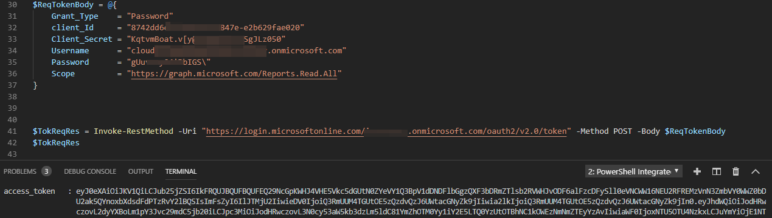
PASSWORD - STITCHING THE COMPONENTS
REQUESTING TOKEN
26

Slide 27
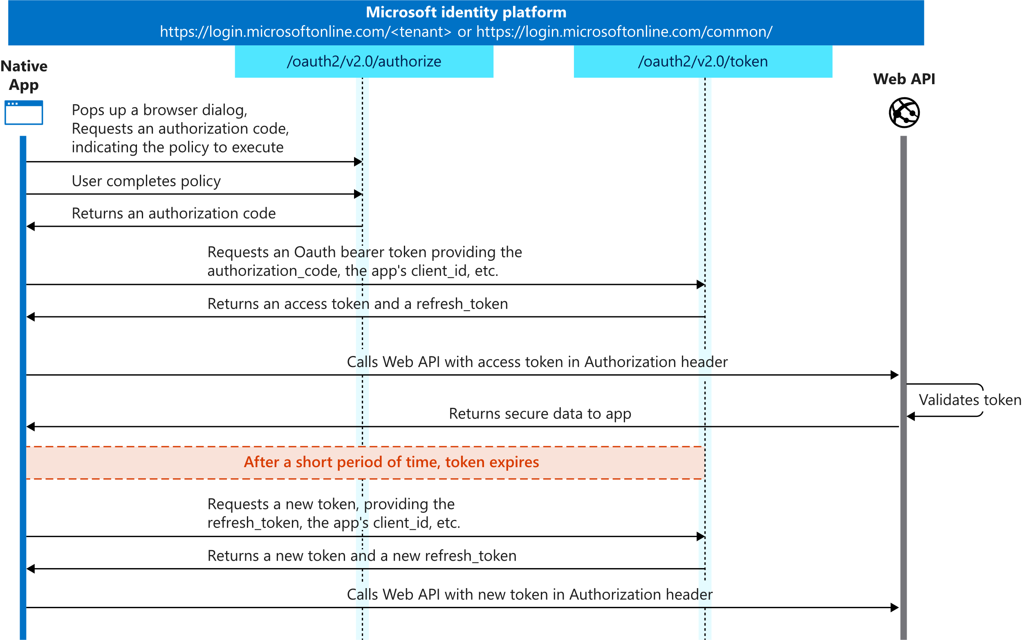
AUTHENTICATE TO GRAPH API
GRANT TYPES
Authorization_Code
Auth Request URL:
https://login.microsoftonline.com/{tenantID}/oauth2
/v2.0/authorize?client_id={clientID}
&redirect_uri={RedirectURI}&scope={Scope}
&response_type=code
Token Request POST Body:
Grant_Type = Authorization_Code
Client_ID = “{ClientID}”
Client_Secret = “{Client Secret}”
Scope = https://graph.microsoft.com/{permission.code}
Code = “{Authorization Code}”
Redirect_Uri = {Redirect URI in the Azure App}
27

Slide 28
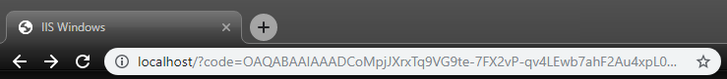
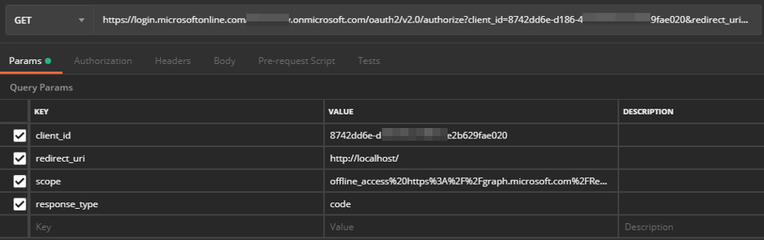
AUTHORIZATION CODE - STITCHING THE COMPONENTS
AUTHORIZATION
28

Slide 29
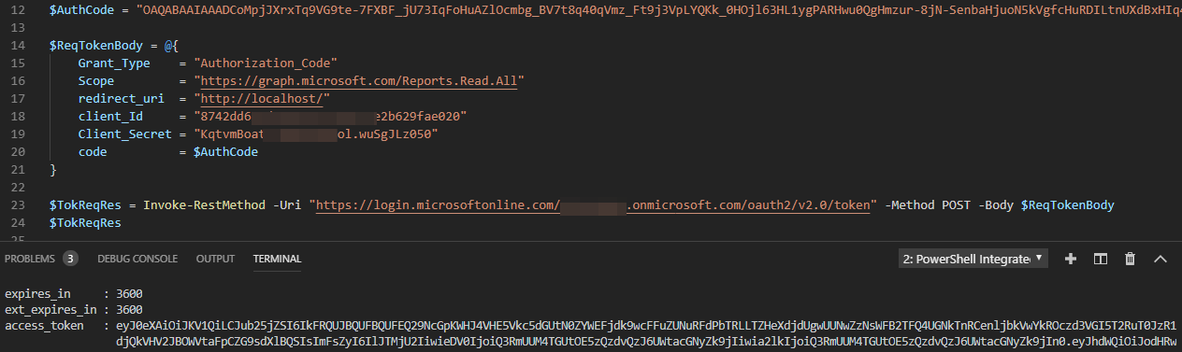
AUTHORIZATION CODE - STITCHING THE COMPONENTS
REQUESTING TOKEN
29

Slide 30
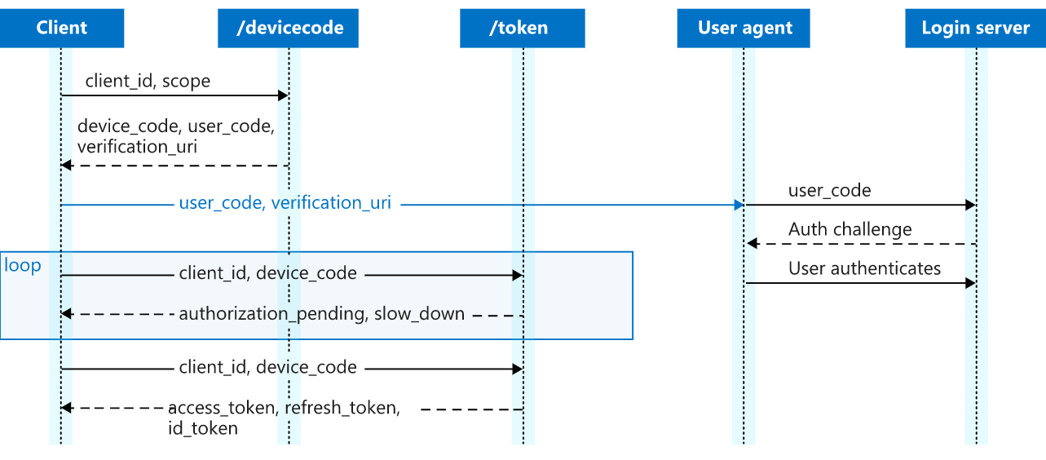
AUTHENTICATE TO GRAPH API
GRANT TYPES
Device_Code
Auth Request POST Body:
Client_ID = “{Azure App Client ID}”
Code = “{Device Code}”
Send to:
https://login.microsoftonline.com/{tenant}
/oauth2/v2.0/devicecode
Token Request POST Body:
Grant_Type = “Device_Code”
Client_ID = “{Azure App Client ID}”
Code = “{Device Code}”
30

Slide 31
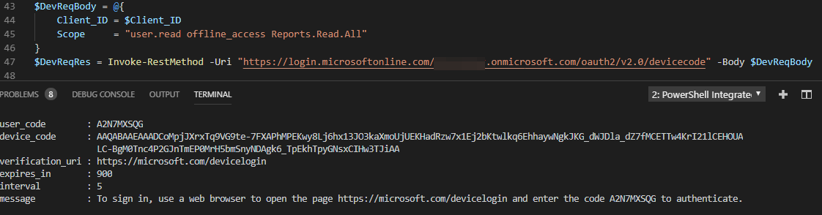
DEVICE CODE - STITCHING THE COMPONENTS
AUTHORIZATION REQUEST
31

Slide 32
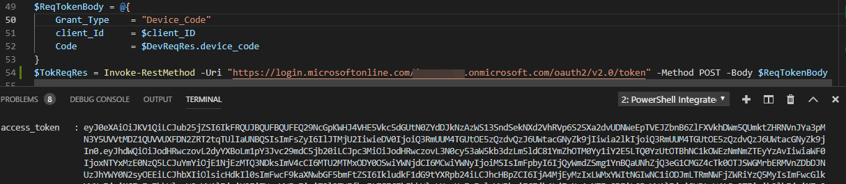
DEVICE CODE - STITCHING THE COMPONENTS
REQUESTING TOKEN
32

Slide 33
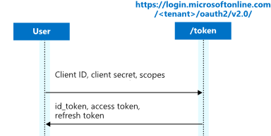
AUTHENTICATE TO GRAPH API
GRANT TYPES
\
Refresh_Token
Required POST Body:
Grant_Type = Refresh_Token
Client_ID = “{Azure App Client ID}”
Client_Secret = “{Azure App Client Secret}”
Refresh_Token = “{Refresh Token}”
Redirect_URI = “{Redirect URI}”
Scope = https://graph.microsoft.com/{permission.code}
33

Slide 34
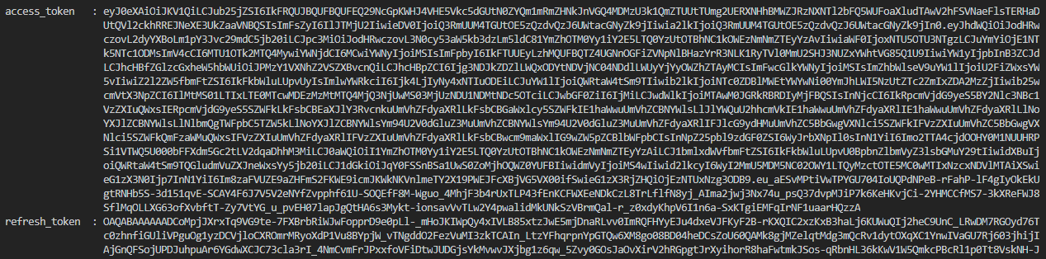
REFRESH TOKEN - STITCHING THE COMPONENTS
REQUESTING TOKEN
34

Slide 35
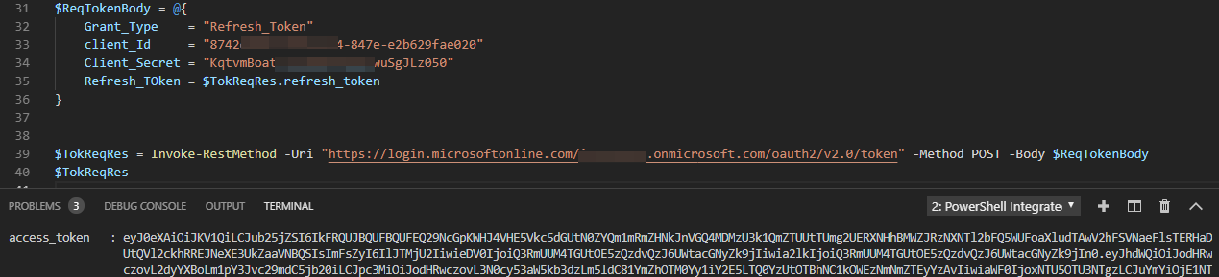
REFRESH TOKEN - STITCHING THE COMPONENTS
REQUESTING TOKEN
35

Slide 36
NAVIGATING MICROSOFT GRAPH WITH POWERSHELL
DEMO – BRAD
36

Slide 37

Questions / Open Discussion
37

Slide 38

HELPING YOU THRIVE THROUGH TECHNOLOGY AND TALENT

